Slide 2
Operationalizing Deep Neural Networks on Azure
Thomas Delteil
Data Scientist, Microsoft ADS, London
linkedin.com/in/thomasdelteil
Slides: https://github.com/aiimmersion/aiimmersion-resources

Slide 3
Session Goals
Overview of Azure platforms for Deep Learning
How to go from trained network to operational model
Get a sense of what platform to choose when
Notes:
This slide is required. Do NOT delete. This should be the first slide after your Title Slide.
This slide should describe what your goals are for this session. This information lets your audience know what you are trying to accomplish with your talk or tutorial—ie, what value will attendees get by investing 25 minutes or 2 hours of their time listening to you.
You should not spend more than 1 minute presenting this slide.
General examples of session goals could be (you will have to create your own specific goals):
Introduce a new technique or approach to solve a customer problem
Compare two approaches and explain why one is superior
Describe a project and the learnings that audience members can apply from it
Teach audience members how to use a specific technology

Slide 4
Agenda
Training of a Deep Neural Network on GPU infrastructure
Scoring a trained Deep Neural Network
Batch scoring
Real-time scoring

Slide 5
Training the network

Slide 6
Training the network
Training Deep Neural Networks is computationally expensive
GPUs reduce training time between 6x-40x
N-Series VMs
Notes:
Currently the preferred way of training DNN

Slide 7




Azure Batch Shipyard
Open-source utility built on top of Azure Batch Service
Cloud-scale job scheduling and compute management
Data Staging and compute pipelines executions
Task as containerized Docker workloads
Task dependencies for complex workflows
Tasks
Storage
Jobs
Pools
Notes:
1- available on github
2- scaling to 1000s of virtual machines for cloud-enabled batch and HPC applications
3- Fileshares, blob storage, external file service
4- docker container as light weight virtual machines
5- one blob to another

Slide 8
Azure Batch Shipyard
Documentation
Examples of GPU training
Rich CLI to create pool, jobs and tasks
Stream files directly from the running container, for e.g stdout or stderr
Monitor the training using TensorBoard

Slide 9


DNN Training Example Workflow with ABS
Create a DNN training script with any DL framework
Package the DNN as a Docker image and upload it to the Azure Container Registry
Create a pool with GPU VMs
Add a job with tasks to run a hyper-parameter sweep experiment tasks
Tasks are scheduled to the pool and the Docker image is downloaded if required
Data is copied to the container
Tasks as containers perform the DNN training
Tasks write results and trained models to storage
3
4
7
1
5
2
DSVM
6
8

Slide 10
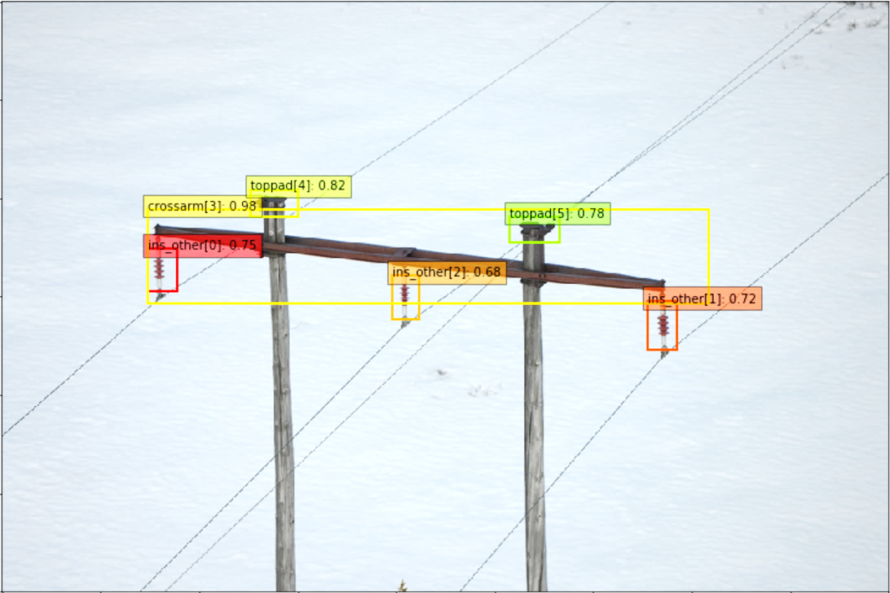
Training on Azure Batch Shipyard
Ideal scenario:
Parameter sweep for model selection of DNN
Multi-node Multi-GPU training of DNN with large dataset
Periodic re-training orchestration using Azure Functions and Azure Batch Shipyard
Example real-world use-case:
Object detection model for damage assessment from drone aerial images
Labels are added everyday on new data by human experts
Model is retrained weekly

Slide 11
Training on Azure Batch Shipyard
Pros
Use of containers makes the environment stable and reproducible, supports GPU VM
Containers can be tested locally before being run at scale
Very large scale (up to 100s of VMs) and auto-scaling formulas
Task dependencies, ingress and egress of data
Azure Function extension for orchestration
Cons
Not yet reaching feature parity with Batch Service (auto-scale through JSON, job scheduling)
Rich CLI but no SDK yet

Slide 12

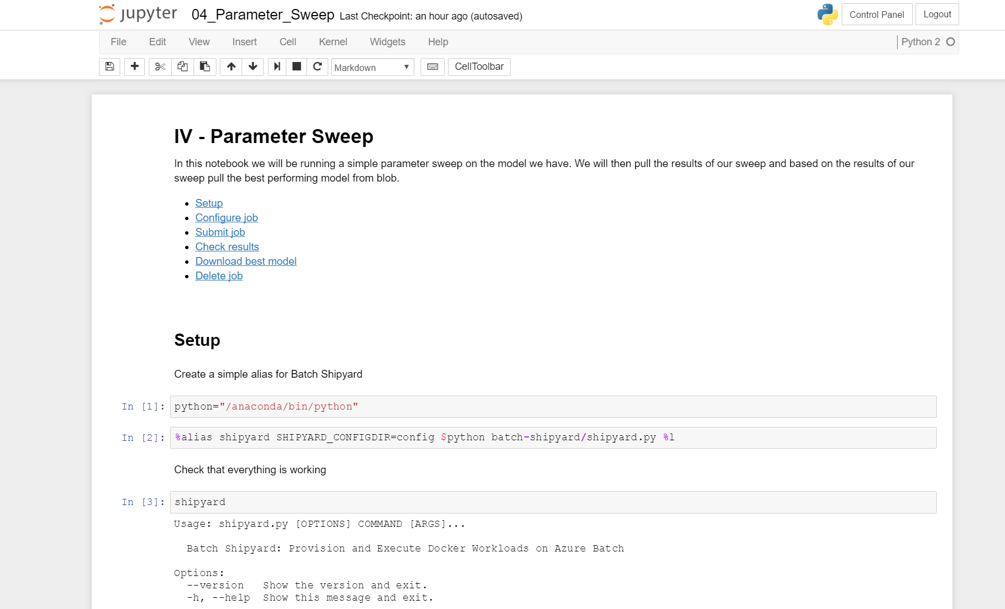
Demo
Training parameter sweep (tutorial on Deep Learning at scale)

Slide 13
Scoring
Batch

Slide 14

Batch Scoring
Scheduled batch data processing
One-off historical data processing
Large workload asynchronous processing
1
Batch Scoring
image classification
0:[car, road]
1:[car, road]
…
2

Slide 15
Batch Scoring on Azure Batch Shipyard
Azure Batch Shipyard (ABS) not only used for training but also for scoring.
Can load from several data sources including:
Blob
Fileshare
glusterFS or HDFS
Failure recovery and task re-scheduling

Slide 16

Demo
https://youtu.be/Khuj4ASldmU?t=45
Style transfer for videos, as described in the paper "Artistic style transfer for videos" by Manuel Ruder, Alexey Dosovitskiy and Thomas Brox http://arxiv.org/abs/1604.08610

Slide 17


Batch Scoring - Example Workflow
Style transfer on videos
Video added to blob storage
Azure Function triggered
Task scheduled to process intervals of the frames using DNN style transfer + a dependent task to join the resulting into a new video using ffmpeg
Pool auto-scales depending on the number of pending tasks and add new nodes
Data ingested, DNN processing occurs and the resulting video is created
Processed video is stored in blob storage
1
2
3
5
6
4
5

Slide 18
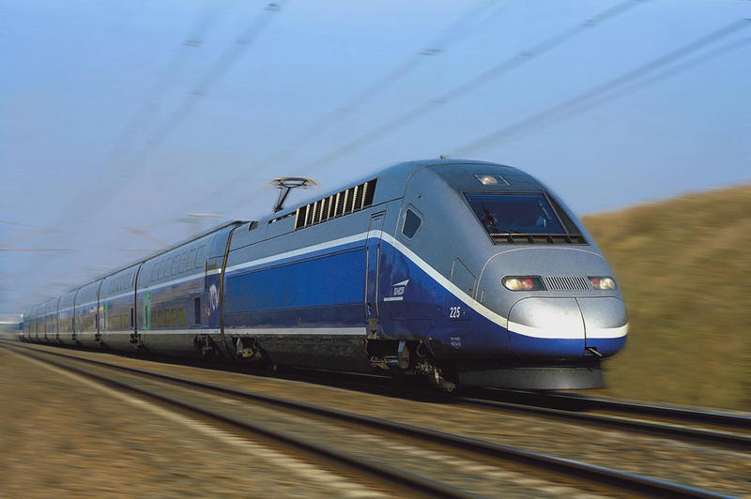
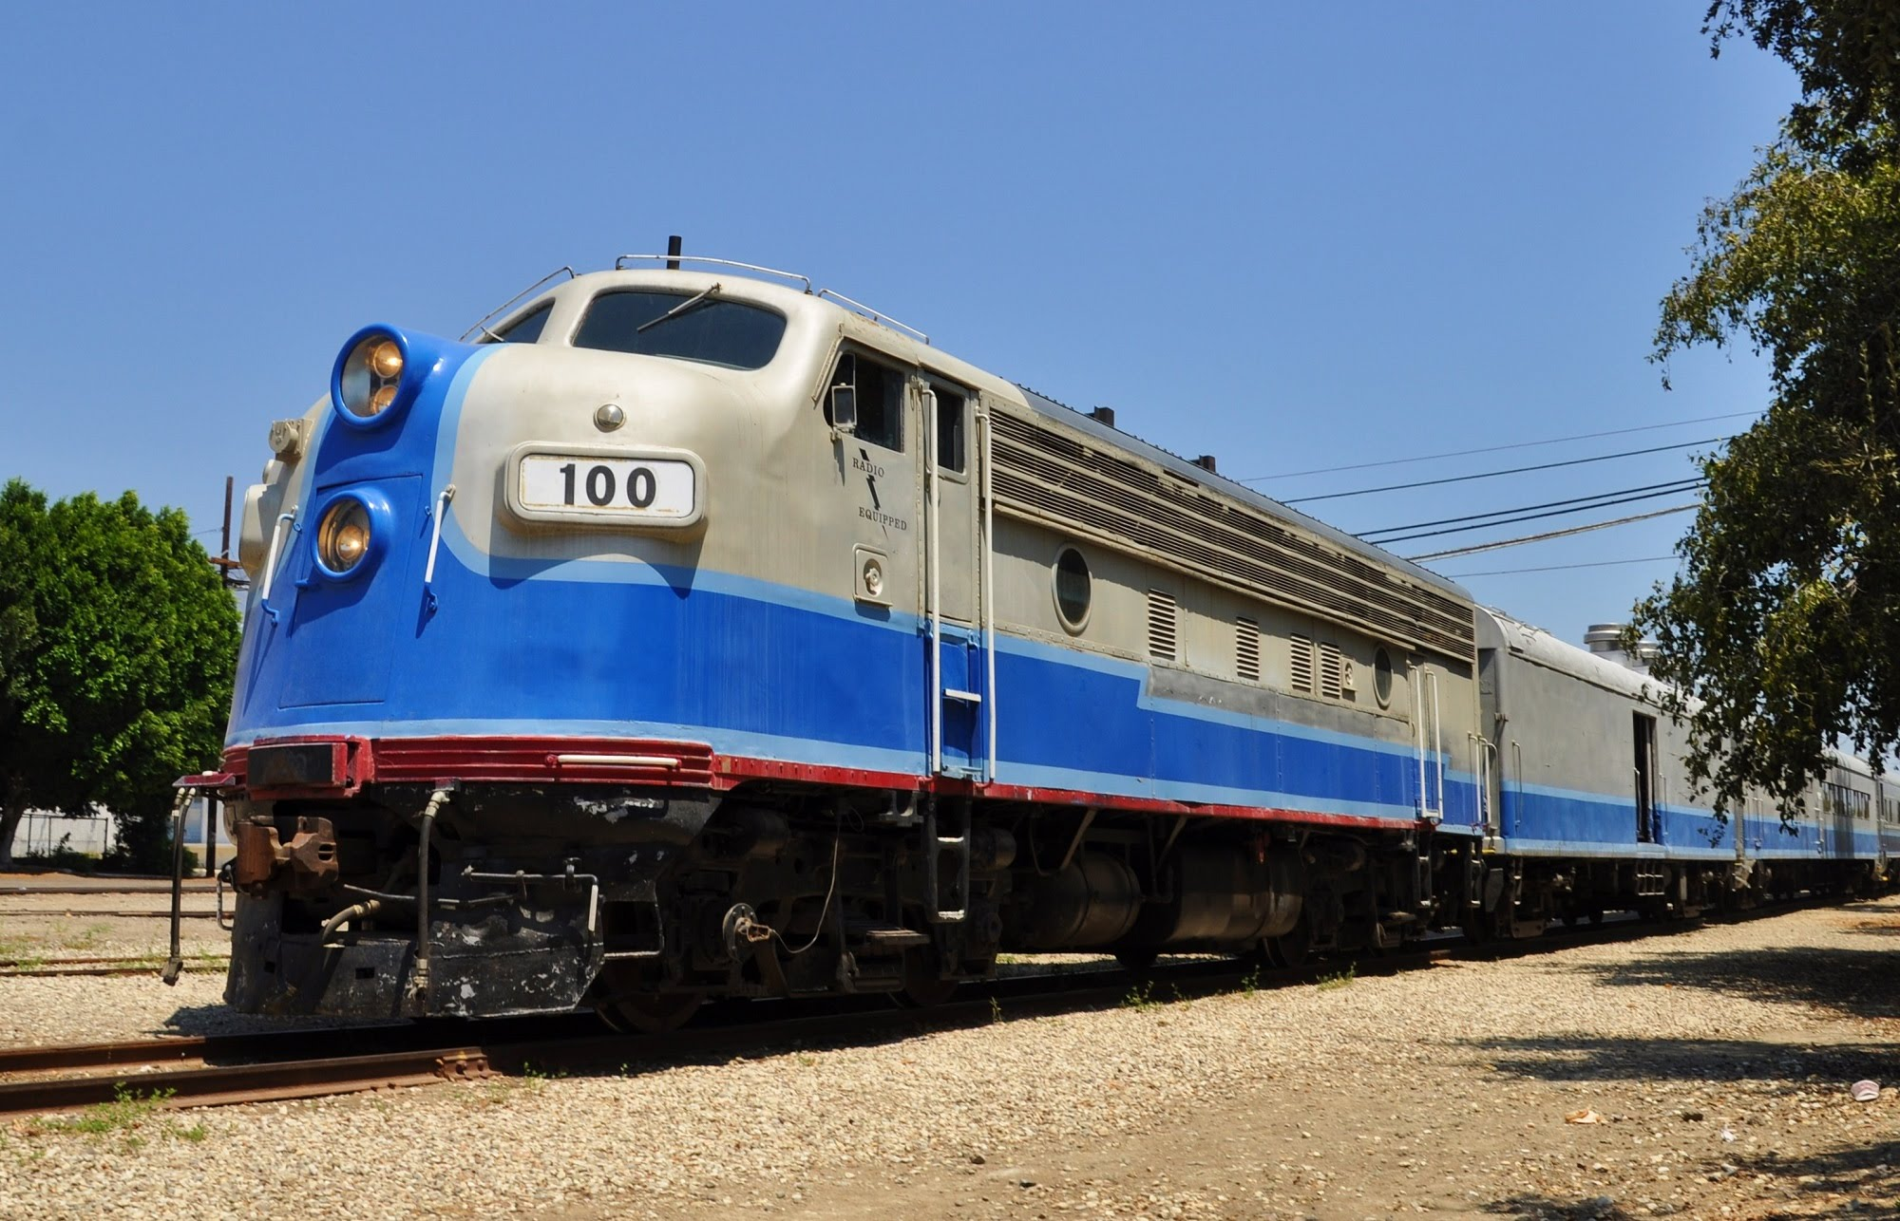

Batch Scoring on Azure Batch Shipyard
Ideal Scenario
Scheduled batch processing of evenly distributed blob containers containing video or image data
Real world use-case
Enriching very large unstructured dataset of historical operational images for a railway company.

Slide 19
Batch Scoring on Azure Batch Shipyard
Pros
Auto-scale up to hundreds of nodes
Task dependency enables complex data processing flow
GPU are available in the compute pools
Cons
No easy way to split a very large unstructured blob container to distribute the processing in a arbitrary number of tasks using the data ingress API

Slide 20
Scoring
Real-time (Request/Response Service)

Slide 21
Real-time scoring
Streaming data pipeline
Serving DL analytics to consumers through an API
Unique challenges:
Complex environment
Cold start: loading model in memory
1
Scoring Service
image classification
[car, road]
2

Slide 22
Real-time scoring using Azure ML Operationalization web-services
Azure ML Operationalization CLI : set of commands developed by the Azure ML team to deploy real-time web-services on a cluster in Azure
Web-services automatically created from
A trained DNN
A python driver file (init(), run())
A requirements.txt file
Any number of other required files

Slide 23
Files packaged as a nginx/flask web-service in a Docker image and stored in a private Azure Docker Registry
web-service testable locally on Docker or deployed remotely on a cluster
Monitoring and management using the Marathon UI
Samples

Slide 24
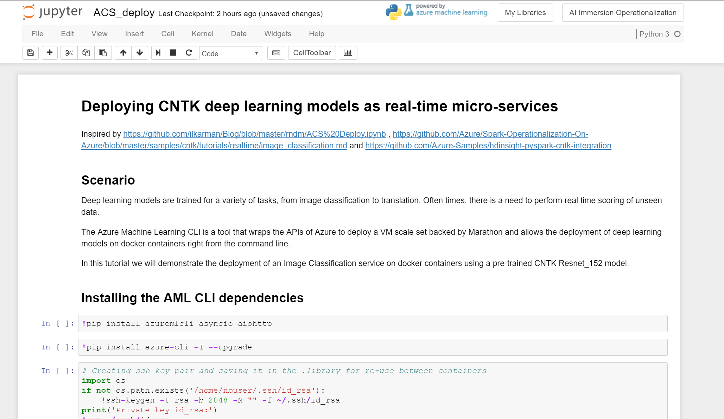
Demo
Deploying Azure ML Operationalization CNTK DNN as web-service

Slide 25
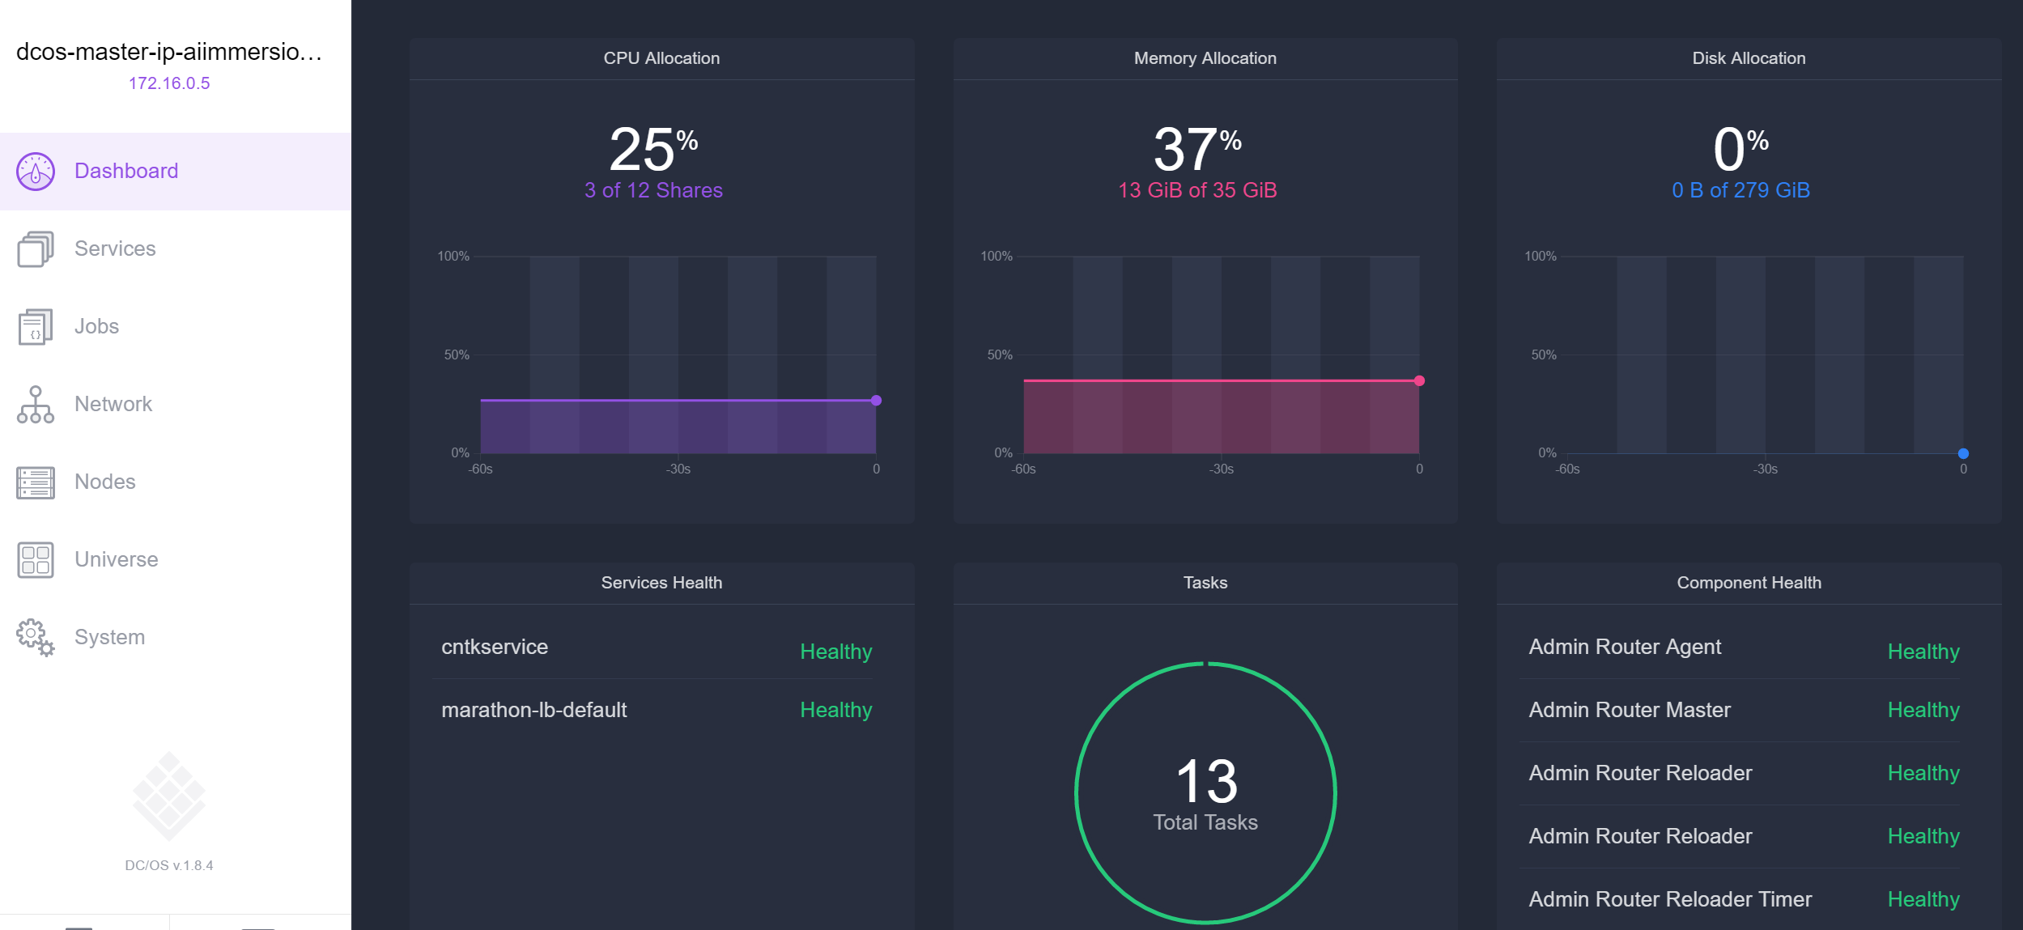
Marathon UI
Manages and monitor the services, scale up and down the number of containers

Slide 26


Example workflow
Create a driver file for a trained DNN
Setup of the cluster from Az ML CLI
Create a web-service, image uploaded to Docker Registry
Deploys web-service locally
Test locally
Deploy to cluster
Send requests to web-service
5
1
4
DSVM
3
2
6
7

Slide 27
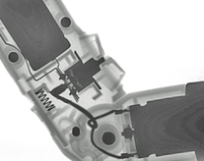
Azure ML Operationalization
Ideal Scenario
Deploy a DNN web-service inside an internal VNet to offer fast, scalable, no-frills DNN analytics over HTTP
Real-world use-case
Scoring live x-ray scans from an assembly line to detect internal failures for high-precision components manufacturing
pass
Scoring Service
image classification
fail

Slide 28
Azure ML Operationalization
Pros
Easy to deploy
No web development skills needed
Scalable
Monitoring UI for service management
Cons
Requirements.txt is the only environment configuration tool
Points to a single version of the deep learning frameworks
Still in active development

Slide 29
Conclusion

Slide 30
Trade-offs
Performance vs Cost (GPU vs CPU)
Simplicity vs Versatility
Unicity vs Multiplicity

Slide 31
Key Recommendations
DSVM for explorative training
Azure Batch Shipyard for programmatic and scheduled training, batch workloads
Azure ML Operationalization for real-time scoring
Bring compute to your data with HDInsight on Spark or SQL Server 2017

Slide 32
Going further
Download the slides and check out the appendix!
Training on DSVM
Real-time scoring on Azure Container Service
Real-time scoring on Azure Web App
Real-time scoring on Azure Web App for linux
Batch scoring on HDInsight on Spark (stay tuned)
Batch scoring on SQL Server 2017
https://github.com/aiimmersion/aiimmersion-resources

Slide 33
Acknowledgements
Fred Park
Mathew Salvaris
Miguel Fierro
Ilan Reiter
Ilia Karmanov
Alex Sutton
Mary Wahl

Slide 34
Thank you
Thomas Delteil – linkedin.com/in/thomasdelteil

Slide 35
Appendix

Slide 36
Glossary
ABS: Azure Batch Shipyard
ACS: Azure Container Service
ADLA: Azure Data Lake Analytics
ADLS: Azure Data Lake Storage
CLI: Command Line Interface
DL: Deep Learning
DNN: Deep Neural Networks
DSVM: Data Science Virtual Machine
HDFS: Hadoop Distributed File System
IDE: Integrated Development Environment
I/O: Input/Output
ML: Machine Learning
PaaS: Platform as a Service
PoC: Proof of Concept
SDK: Software Development Kit
VM: Virtual Machine

Slide 37
Training

Slide 38
Training on the Data Science Virtual Machine
Virtual Machine provisioned with the most commonly used deep learning frameworks and utilities
Can be used on GPU VM
Windows or Linux.
Resources:
CNTK tutorials
DSVM overview

Slide 39

Example workflow
User starts and log on DSVM with GPU
Develop the training script in an IDE on the DSVM
Load data and runs the training script on the DSVM
Persist the trained model in permanent storage
2
1
DSVM
3
4

Slide 40
Training on the Data Science Virtual Machine
Pros
Ease of provisioning
Fast feedback cycle
Rich environment with most data science tools
Cons
Replication at scoring time gets harder once the environment is updated
Scaling up to 4 GPU max, limited for hyper-parameter search

Slide 41
Training on the Data Science Virtual Machine
Ideal Scenarios
Exploration and development of deep learning networks
One-off training

Slide 42
Real-time Scoring

Slide 43
Real-time scoring on Azure Container Service
Azure Container Service simplifies the creation, configuration, and management of a cluster of virtual machines
VMs are preconfigured to run containerized applications
It uses an optimized configuration of popular open-source scheduling and orchestration tools
Can be used with tools like Marathon, DC/OS, Docker Swarm or Kubernetes

Slide 44

RT Scoring - Example workflow
1
2
Build your containerized web-service Docker image
Test locally on the DSVM
Upload to the registry
Create Azure Container Service cluter
Use Docker swarm to deploy it to ACS
Send requests to your web-service
DSVM
3
5
4
6

Slide 45
Real-time scoring on Azure Container Service
Ideal Scenario
Existing expertise in Docker container orchestration that can be fully leveraged, or existing ACS cluster that can be used
You have a need to use a custom Docker image, e.g. to point to specific versions of Deep Learning frameworks

Slide 46
Real-time scoring on Azure Container Service
Pros
Choice of container orchestration framework
Flexibility of custom Docker images
Scaling tools and utilities that come with container orchestration tools
Cons
Manual set-up of the web-service
Minimum 3 nodes for a container service cluster (Master, Public, Private)

Slide 47
Real-time scoring on Azure Web App
App Service Web Apps is a fully managed compute platform that is optimized for hosting websites and web applications. (PaaS)
Windows web app CNTK DNN deployment example
Features:
Log monitoring
Swagger API Specs
Live console
Git deployment integration
Live code editor
Performance testing
…

Slide 48
RT Scoring - Example workflow
Develop and test locally a flask web-service that load the model in memory and handles requests
Create a deployment script to set-up the dependencies on the Azure App Service env
Git commit and push to repo
Deployment triggered on Azure Web App
Send requests to the Web App
1
2
DSVM
3
4
5

Slide 49
Real-time Scoring on Azure Web App
Ideal Scenario
You want to expose your Deep Learning analytics to external customers and take advantage of the advanced deployment options as well as traffic and performance monitoring of Azure Web App

Slide 50
Real-time Scoring on Azure Web App
Pro
Features of a managed environment (traffic monitoring, logging, git integration, performance test, Swagger specs, traffic routing, staging)
Multiple hosting plans available
Cons
Environment can be fiddly to configure
Specific Windows binaries of Deep Learning frameworks and libraries can be hard to find or compile

Slide 51
Real-time Scoring on Azure Web App for Linux
Web App on Linux (preview) are the Linux cousin of the Azure Web App
Allows the deployment of custom containers on top of Linux web app hosts
No cluster or container orchestration management overhead

Slide 52
RT Scoring - Example workflow
Develop and test locally a flask-based web-service container that loads the model in memory and handles requests
Build and upload the Docker image to a registry
Trigger deployment of Azure Web App
Send requests to the Web App
1
2
DSVM
2
3
4

Slide 53
Real-time Scoring on Azure Web App for linux
Ideal Scenario
Need a low cost platform to deploy a single instance of a container for a low traffic DNN analytics service

Slide 54
Real-time Scoring on Azure Web App for Linux
Pros
Easiest way to deploy a containerized web-service
Ability to deploy a container on a low-cost plan
Cons
Far from feature parity with Azure Web App (still in Preview)
Cannot access the containers to inspect the files (only stdout/stderr)

Slide 55
Batch Scoring

Slide 56
Batch Scoring on HDInsight on Spark
HDInsight : Azure cluster offering coming with Hadoop and Spark.
Deep Learning frameworks can be installed on the worker nodes of the cluster using script actions
pySpark to connect to the spark compute context and score data in a distributed way
Example notebook, scoring of CIFAR10 on Spark with CNTK

Slide 57

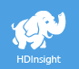
Example Workflow
Connect to Jupyter notebook on the edge node
Start the spark compute context
List the files on ADLS to process
Distribute the filepaths dataset across the nodes
Run the processing in parallel on the worker nodes
Collect the predictions on the edge node
Store the predictions in SQL database
1
7
EDGE
2
6
3
4
5

Slide 58
Batch Scoring on HDInsight on Spark
Ideal Scenario
Azure Data Lake Store (ADLS) used to store hundreds of millions of images. HDInsight Spark cluster using this data lake as underlying storage.

Slide 59
Batch Scoring on HDInsight on Spark
Pros
Spark data structures (rdd, dataset) enable data partitioning and spread the compute evenly across the worker nodes
Azure Data Lake Storage as the back-end storage of the cluster to reduce the I/O latency
DNN processing as a step in a complex data pipeline
Cons
Fragile environment configuration and hard to recover
No out-of-the-box auto-scale

Slide 60
Batch Scoring using SQL Server 2017
SQL Server 2017 is the latest version of the Microsoft SQL database.
Supports Python and R scripts as stored procedures
Fully leverage the data management of the database to minimize I/O latency
Example: Lung cancer detection on SQL Server 2017

Slide 61

Example Workflow
Set up SQL Server 2017 GPU-host with the necessary Deep Learning libraries
Develop DNN scoring module in Python
Register stored procedures to process unseen data
Execute stored procedure
Store predictions in a table
2
DSVM
1
3
4
5

Slide 62
Batch Scoring on SQL Server 2017
Ideal Scenario
Critical data stored in a SQL Server 2017 instance. SQL Server 2017 on a GPU-VM
Real-world use-case:
Medical scans to be processed for cancer and anomaly detections. The images are stored in the DB and processed on-demand via a stored-procedure execution. Results are immediately available and raw scans never leave the instance

Slide 63
Batch Scoring on SQL Server 2017
Pros
No data transfer latency
One system for storage and scoring
Improved data security, raw data stays in the DB
Not limited to batch scoring, also training
Resource governance from SQL Server
Cons
Environment is self managed
Limited to single-node processing
No continuous integration / delivery out-of-the-box

Slide 64
Other Azure platforms

Slide 65
Other Azure platforms
Azure Data Lake Analytics using the R or Python extension (PoC stage)
Azure Function (too slow for most DL scenarios)
Batch Job on Spark using Azure ML Operationalization (PoC stage)

